Slide 1

DATA SCIENCE • BOOK ANALYTICS
From Raw API Data
to Insight
Data Collection • Data Wrangling • Visualization on the Open Library book dataset
2,081
8
33
10
books collected
genres
clean columns
charts
Notes:
This section walks through how we collected the data from the Open Library API, how we cleaned and transformed it, and what the visualizations show.

Slide 2




OUR WORKFLOW
Collection → Wrangling → Visualization
01
02
03
DATA COLLECTION
DATA WRANGLING
VISUALIZATION
Open Library API
pandas
matplotlib
Subjects API for 8 genres
Async enrichment: ratings, shelves, pages, authors
Retry on rate limit + checkpoints
Fix formatting & standardize genres
Remove incorrect values & duplicates
Handle missing values, add features
10 charts in the deck's theme
Genre, time, rating & reader trends
Insights from cleaned data
02 / 12

Slide 3



DATA COLLECTION • STEP 1
Fetching Books from the Open Library API
api_call.py
Send a request
url = "https://openlibrary.org/subjects/thriller.json"
params = {"limit": 40}
for attempt in range(1, 6):
response = requests.get(url, params=params,
headers=headers, timeout=10)
if response.status_code == 429: # rate limited
time.sleep(5 * attempt) # wait, then retry
continue
break
books = []
for item in response.json()["works"]:
books.append({
"Title": item.get("title", "Unknown"),
"Author": ", ".join(a["name"] for a in item["authors"]),
"Publish_Year": item.get("first_publish_year"),
"Edition_Count": item.get("edition_count", 0),
"Open_Library_Key": item.get("key", ""),
})
pd.DataFrame(books).to_csv("my_openlibrary_books_data.csv")
GET /subjects/{genre}.json, repeated for 8 genres
Handle rate limits
HTTP 429 → wait 5s, 10s, 15s… and retry
Keep what we need
Title, author, year, editions, ebook, subjects
Store the dataset
DataFrame → CSV (UTF-8)
03 / 12
Notes:
We call the Open Library Subjects API for each genre. If the server says we are sending too many requests (status 429), the script waits a little longer each time and tries again. From the JSON response we keep only the fields we need and save them as a CSV.

Slide 4




DATA COLLECTION • STEP 2
Enriching Every Book with Async Requests
data_collection.py
4 API CALLS PER BOOK
semaphore = asyncio.Semaphore(25) # 25 requests at once
async def process_one_book(session, semaphore, idx):
key = df.at[idx, "Open_Library_Key"]
async with semaphore:
ratings, shelves, editions, author = await asyncio.gather(
fetch_json(session, f"{BASE}{key}/ratings.json"),
fetch_json(session, f"{BASE}{key}/bookshelves.json"),
fetch_json(session, f"{BASE}{key}/editions.json"),
get_author_details(session, df.at[idx, "Author"]))
df.at[idx, "Average_Rating"] = ratings["summary"]["average"]
df.at[idx, "Want_To_Read_Count"] = shelves["counts"]["want_to_read"]
df.at[idx, "Author_Birth_Date"] = author["birth_date"]
if processed_count % 30 == 0: # checkpoint save
df.to_csv(csv_file, index=False)
ratings.json
Average rating, rating count
bookshelves.json
Want to read / reading / read
editions.json
Page count
search/authors.json
Birth, death date, bio (cached)
25 concurrent connections • resume from progress file
04 / 12
Notes:
For every book we make four more API calls at the same time using asyncio: ratings, reader shelves, editions for page count, and author details. A semaphore limits us to 25 requests at once, author results are cached, and progress is saved every 30 books so the script can resume.

Slide 5
DATA COLLECTION • RESULT
The Raw Dataset: Real, but Messy
Title | Author | Year | Genre | Rating | Pages | Author Birth
The Invisible Man | H. G. Wells | 0 | science_fiction | — | — | —
Dumb Witness | Agatha Christie | 1937 | mystery | 4.0 | 1 | —
Vampire Academy | Richelle Mead, Richelle Mead | 2007 | romance | — | — | —
The Moonstone | Wilkie Collins | 1800 | romance | 4.09 | 720 | —
Americanah | C. N. Adichie | 1969 | romance | 3.85 | 768 | 1977
Treasure Island | R. L. Stevenson | 1880 | thriller | 3.78 | — | 13 November 1850
2,081 × 17
80%
37
6
rows × columns
rows missing enrichment fields
different date formats
duplicate books
05 / 12
Notes:
These are real rows from our CSV. Pink values are problems: a publish year of 0, a novel with 1 page, an author name repeated twice, 1800 used as a placeholder year, Americanah listed as 1969 although the author was born in 1977, and dates written in many formats. This is why wrangling is needed.

Slide 6
DATA WRANGLING • STEP 1
Fix Formatting, Standardize Genres & Dates
book_data_wrangling.py
BEFORE → AFTER
# 1. Clean author names
def clean_authors(s):
names, seen = [], set()
for n in s.split(","):
n = re.sub(r"^adapted by\s+", "", n.strip(), flags=re.I)
if n and n.lower() not in seen:
seen.add(n.lower())
names.append(n)
return ", ".join(names)
df["Author"] = df["Author"].apply(clean_authors)
# 2. Standardize genre labels
df["Genre"] = df["Genre_Category"].map({
"science_fiction": "Sci-Fi", "young_adult": "Young Adult",
"historical_fiction": "Historical Fiction", ...})
# 3. Many date formats -> one ISO format
d = dateutil.parser.parse("13 November 1850")
d.strftime("%Y-%m-%d") # '1850-11-13'
Duplicate author name
R. Mead, R. Mead → R. Mead
Genre label
science_fiction → Sci-Fi
Author birth date
13 November 1850 → 1850-11-13
Author birth date
August 14, 1947 → 1947-08-14
Extra author note
Adapted by S. Spinner → S. Spinner
06 / 12
Notes:
First we clean text: repeated author names and notes like 'Adapted by' are removed. Genre keys like science_fiction become readable labels. Author dates came in 37 formats, so we parse each one and write it as YYYY-MM-DD.

Slide 7
DATA WRANGLING • STEP 2
Remove Incorrect Values & Duplicates
book_data_wrangling.py
BEFORE → AFTER
# Impossible or placeholder publish years -> missing
bad = df["Publish_Year"].lt(1450) | df["Publish_Year"].gt(2026)
bad |= df["Publish_Year"].isin([1800, 1900]) # "century" guesses
bad |= df["Publish_Year"] < df["Author_Birth_Year"] + 10
df.loc[bad, "Publish_Year"] = pd.NA
# 0.0 rating with 0 votes means "no rating", not a score
df.loc[df["Rating_Count"].eq(0), "Average_Rating"] = np.nan
# A novel can't have under 30 pages
df.loc[df["Page_Count"].lt(30), "Page_Count"] = np.nan
# Same title + same author = duplicate -> keep most complete
df = (df.sort_values("_filled", ascending=False)
.drop_duplicates(["_title", "_author"]))
The Invisible Man — year
0 → missing
The Moonstone — year
1800 (placeholder) → missing
Americanah — author born 1977
published 1969 → missing
Dumb Witness — pages
1 → missing
Pride and Prejudice
2 rows → 1 row, 2 genres
07 / 12
Notes:
Next we find values that cannot be true: year 0, placeholder years 1800 and 1900, books published before the author was born, 0.0 ratings with zero votes, and page counts under 30. We set them to missing instead of guessing. Books with the same title and author are merged, keeping the most complete record.

Slide 8
DATA WRANGLING • STEP 3
Handle Missing Values & Create New Features
book_data_wrangling.py
NEW COLUMNS ADDED
# Flag incomplete rows instead of inventing data
df["Is_Enriched"] = df["Want_To_Read_Count"].notna()
# Fill page count with the genre median, and flag it
med = df.groupby("Genre")["Page_Count"].median()
mask = df["Page_Count"].isna() & df["Is_Enriched"]
df.loc[mask, "Page_Count"] = df.loc[mask, "Genre"].map(med)
df["Page_Count_Imputed"] = mask
# New features for analysis
df["Decade"] = df["Publish_Year"] // 10 * 10
df["Total_Readers"] = df[["Want_To_Read_Count",
"Currently_Reading_Count", "Already_Read_Count"]].sum(axis=1)
df["Length_Category"] = pd.cut(df["Page_Count"],
[0, 200, 350, 500, np.inf],
labels=["Short", "Medium", "Long", "Epic"])
Decade
Era
Book_Age
Total_Readers
Completion_Rate
Length_Category
Popularity_Tier
Author_Status
Is_Enriched
Page_Count_Imputed
READY DATASET
2,081 × 17 → 2,075 × 33
rows × columns
08 / 12
Notes:
The enrichment finished for only 419 books, so we flag those rows instead of filling fake averages. Missing page counts for enriched books are filled with the genre median and marked as imputed. Then we add new columns such as decade, total readers and length category. The final dataset has 2,075 rows and 33 columns.

Slide 9
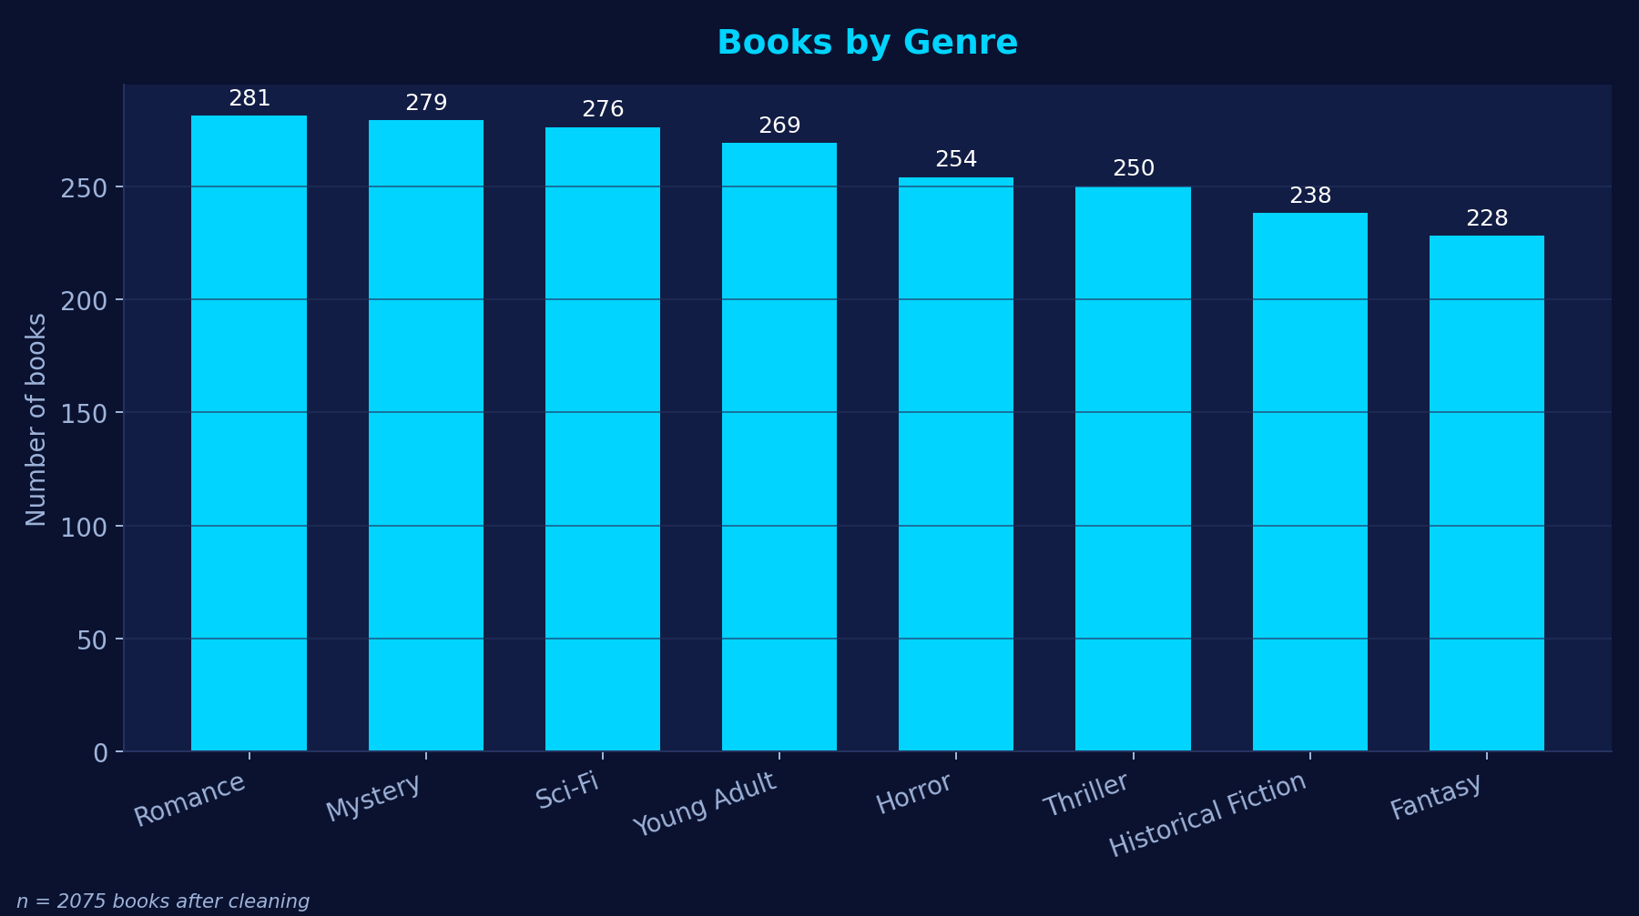
VISUALIZATION • HOW
Building the Charts with Matplotlib
book_data_wrangling.py
# One theme for every chart (matches our slides)
plt.rcParams.update({
"figure.facecolor": "#0a1230",
"axes.facecolor": "#121d45",
"text.color": "#ffffff"})
vc = df["Genre"].value_counts()
fig, ax = plt.subplots(figsize=(10, 5.6))
bars = ax.bar(vc.index, vc.values, color="#00d4ff")
ax.bar_label(bars, padding=3)
ax.set_title("Books by Genre")
ax.set_ylabel("Number of books")
fig.savefig("charts/01_books_by_genre.png", dpi=180)
Insight: genres are well balanced — Romance is largest (281), Fantasy smallest (228), so comparisons between genres are fair.
09 / 12
Notes:
Every chart uses the same dark theme so it fits our slides. For example, value_counts gives the number of books per genre, and a bar chart shows it. The genres are close in size, so comparing them is fair.

Slide 10
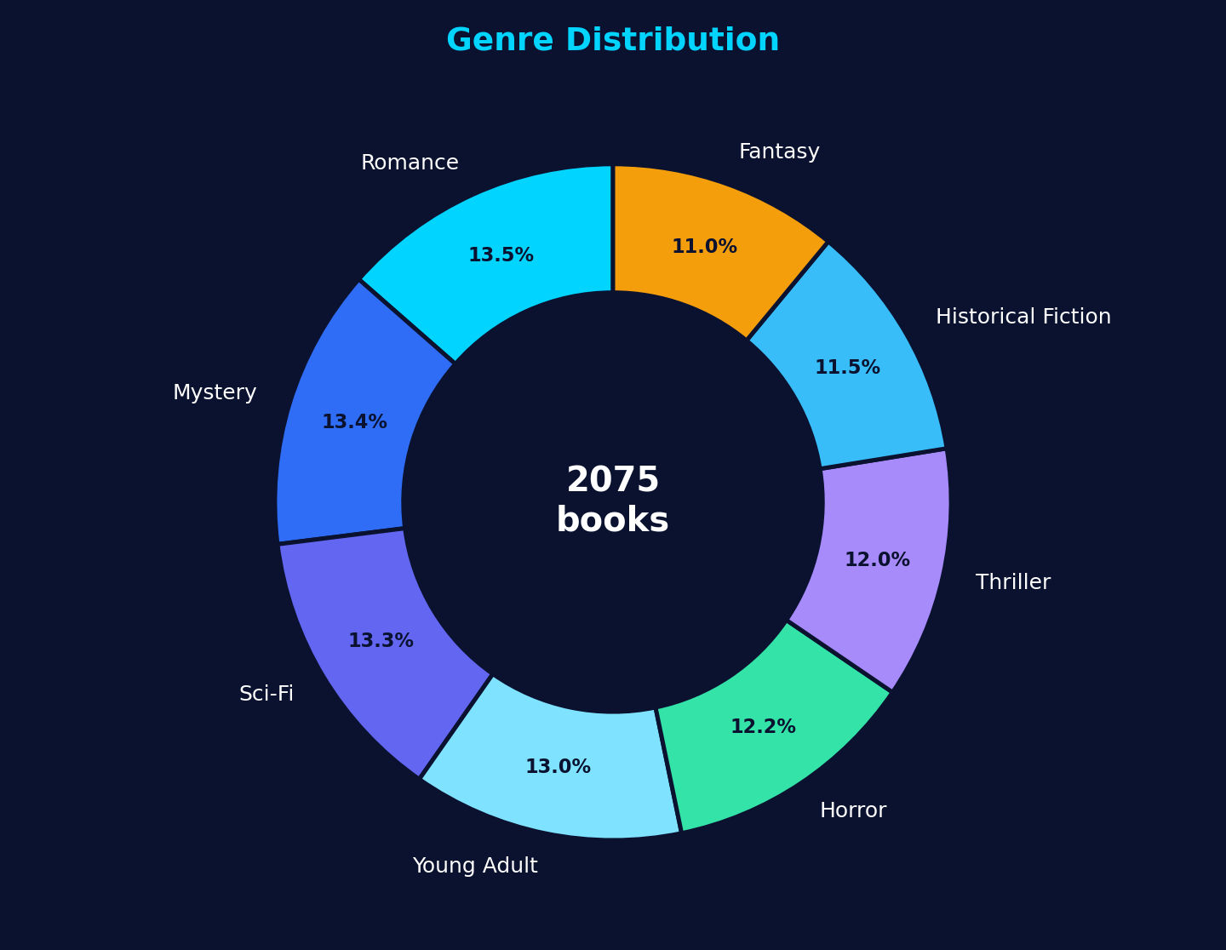
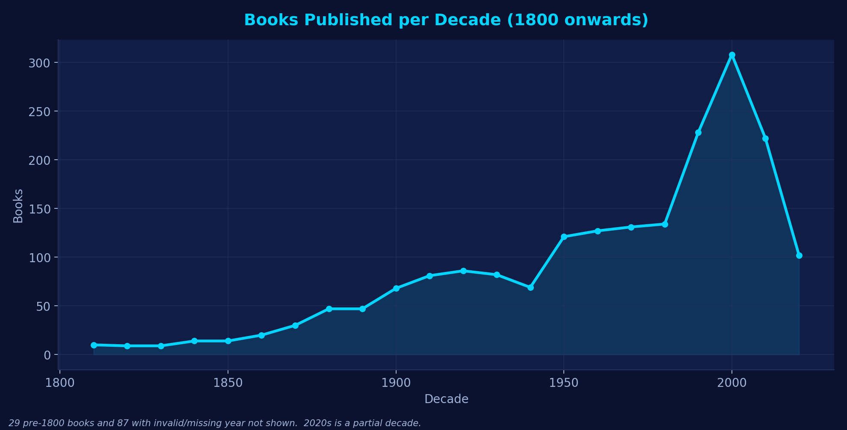
VISUALIZATION • GENRES & TIME
Genre Distribution and Publishing Over Time
donut chart
line chart
ax.pie(vc.values, labels=vc.index,
autopct="%1.1f%%",
wedgeprops=dict(width=0.38))
dec = df["Decade"].value_counts().sort_index()
ax.plot(dec.index, dec.values, marker="o")
ax.fill_between(dec.index, dec.values, alpha=0.12)
Insight: every genre holds 11–14% of the books.
Insight: publishing peaks in the 2000s (308 books); the 2020s look lower only because the decade isn't over.
10 / 12
Notes:
The donut shows each genre's share, all between 11 and 14 percent. The line chart counts books per decade: publishing grows strongly after 1950 and peaks in the 2000s.

Slide 11
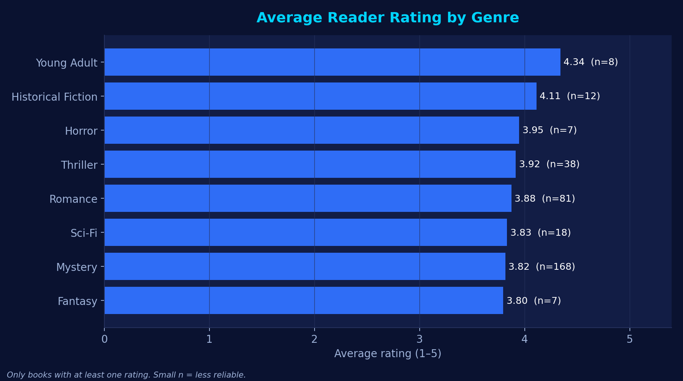
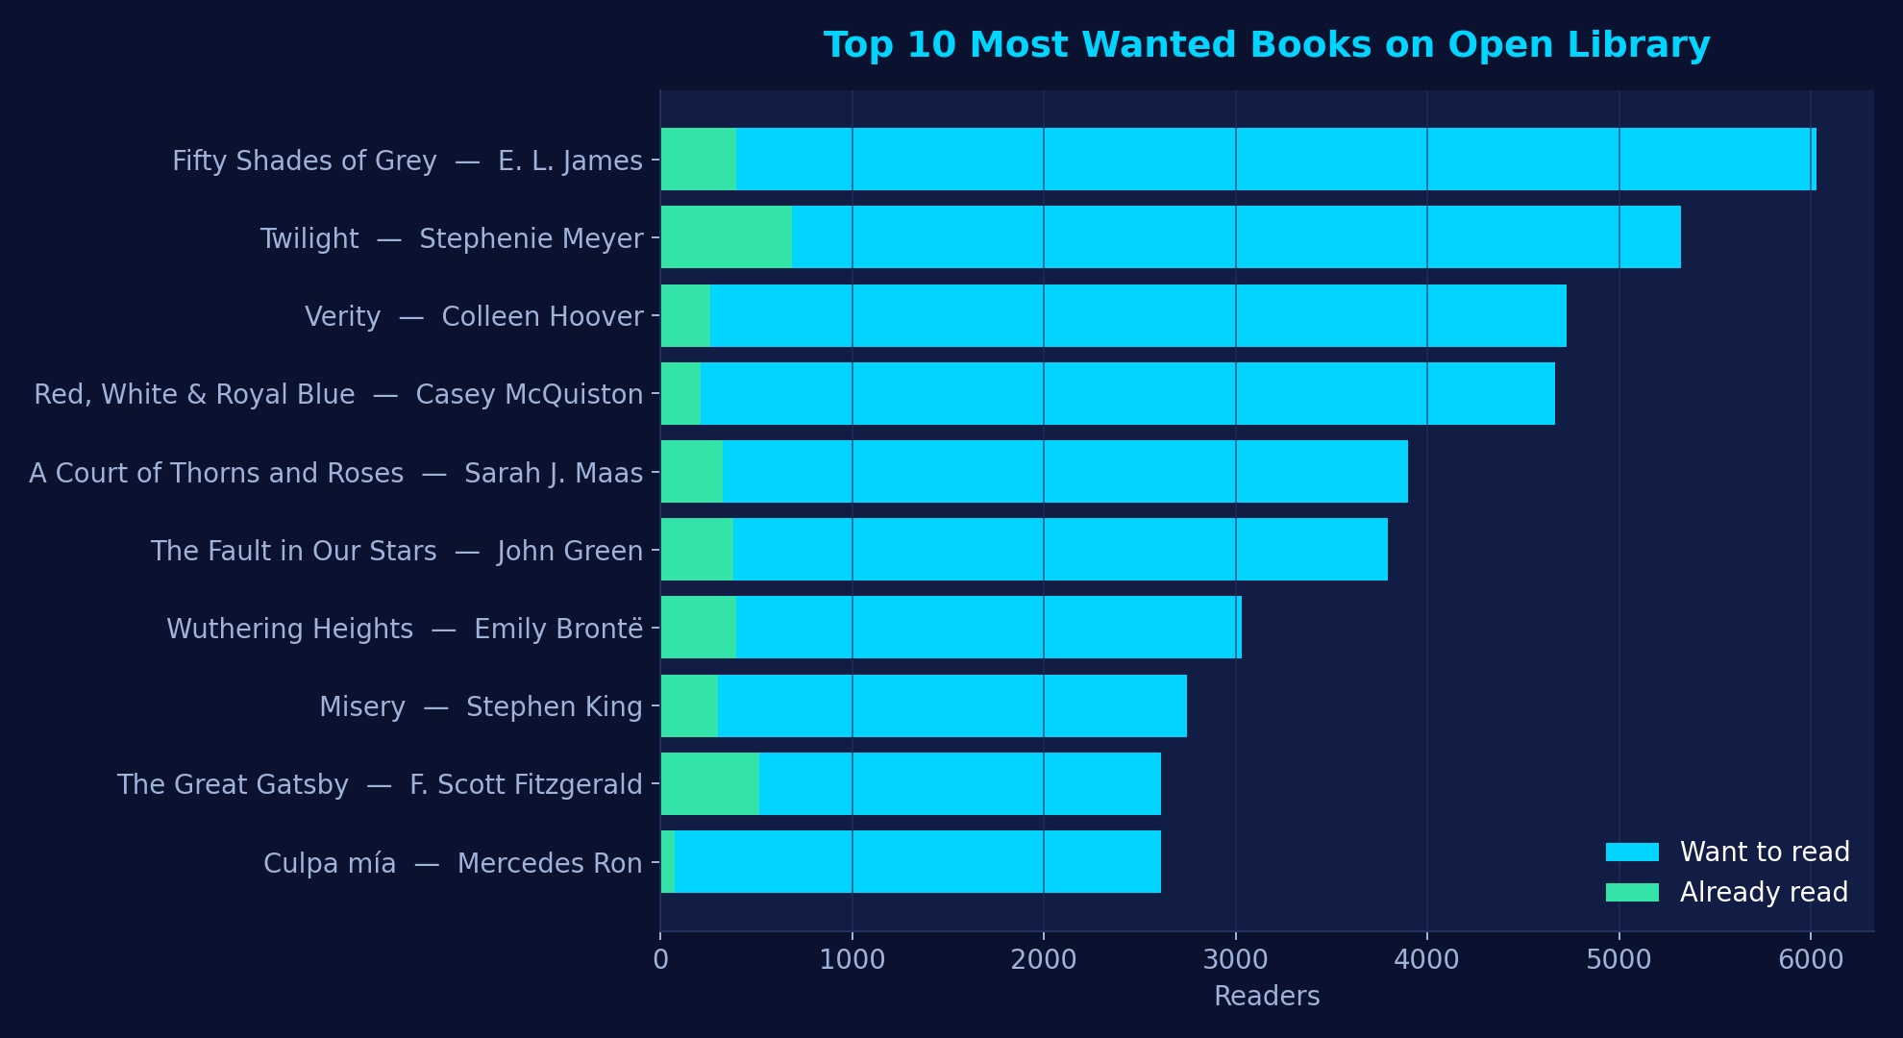
VISUALIZATION • READERS
What Readers Rate and Want to Read
average rating by genre
top 10 most wanted
rs = df.groupby("Genre")["Average_Rating"].mean()
ax.barh(rs.index, rs.values)
top = df.nlargest(10, "Want_To_Read_Count")
ax.barh(top["Title"], top["Want_To_Read_Count"])
Young Adult has the highest average rating (4.34)
Fifty Shades of Grey is the most wanted (6,030 readers)
11 / 12
Notes:
Using the enriched books, groupby gives the average rating per genre; Young Adult is highest. nlargest finds the ten books most people want to read; Fifty Shades of Grey and Twilight lead.

Slide 12
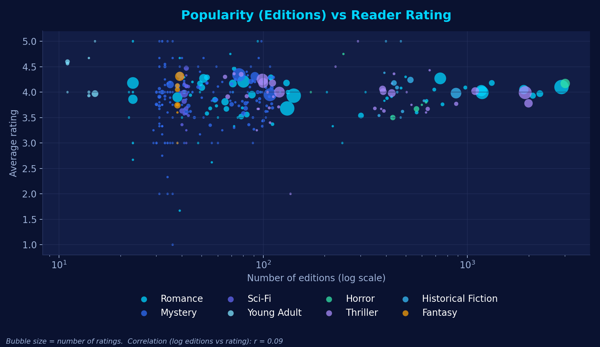
VISUALIZATION • WHAT WE LEARNED
Key Insights from the Clean Data
r = 0.09
More editions ≠ higher rating. Popularity and quality are different things.
2000s
The busiest publishing decade in our dataset (308 books).
90%
Books with a free ebook; Young Adult is lowest at 52%.
308
Median book length in pages.
Each bubble is a book: editions (x) vs rating (y). No clear upward trend.
12 / 12
Notes:
Our main takeaways: books with many editions are not rated higher, publishing peaked in the 2000s, most books have a free ebook, and a typical book is about 300 pages. Rating insights come from the 419 books where enrichment finished.

